Slide 1
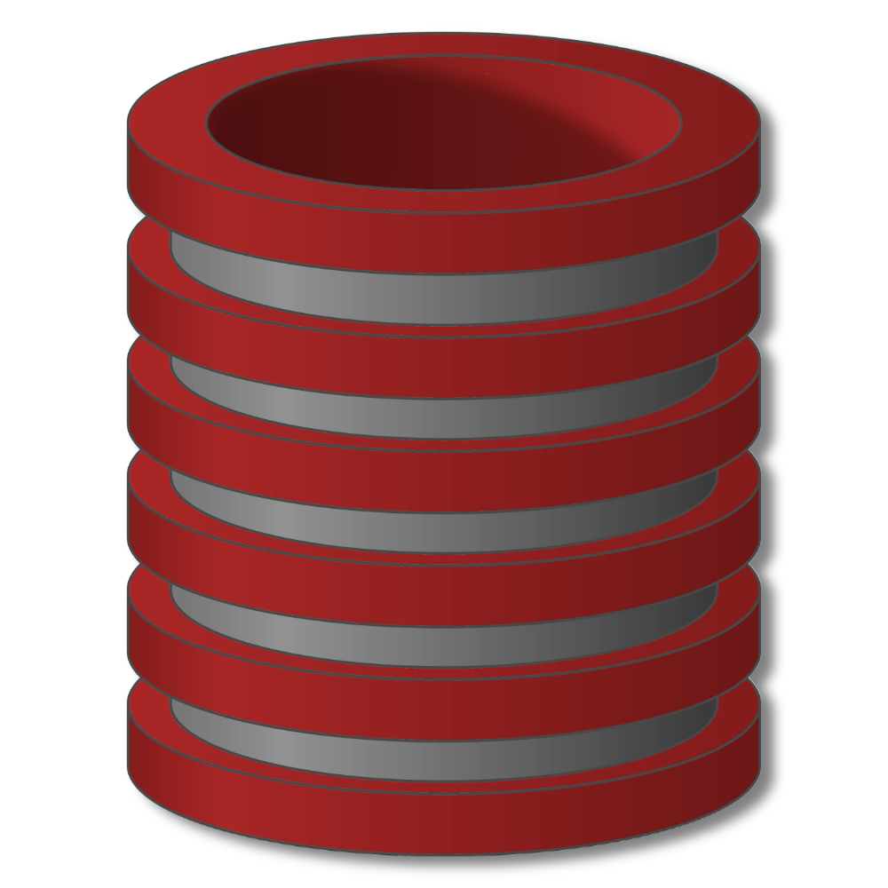
Constraints , data Architecture and Independence

Slide 2
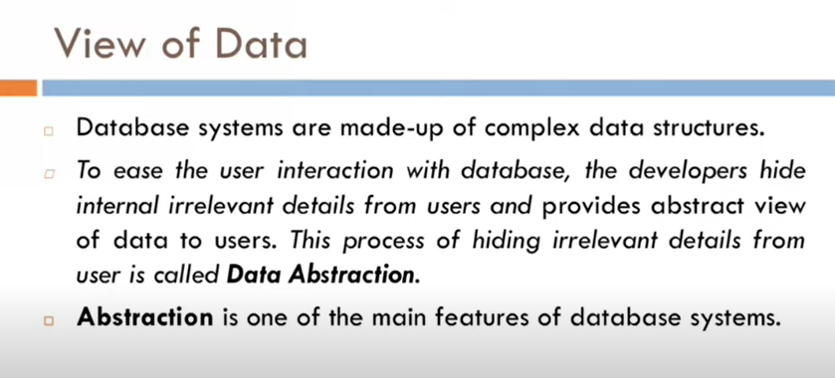
Constraints,Data independence and database Architecture

Slide 3
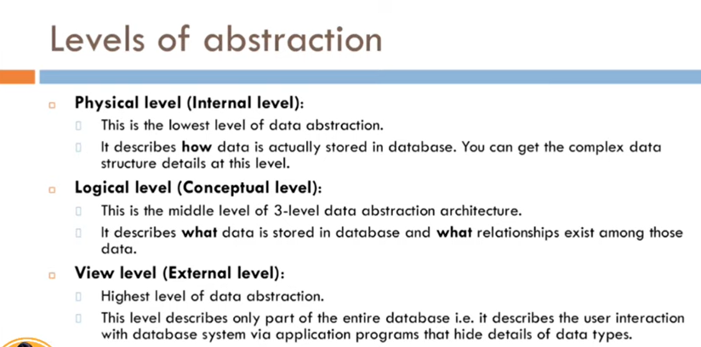

Slide 4
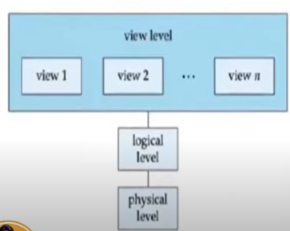

Slide 5
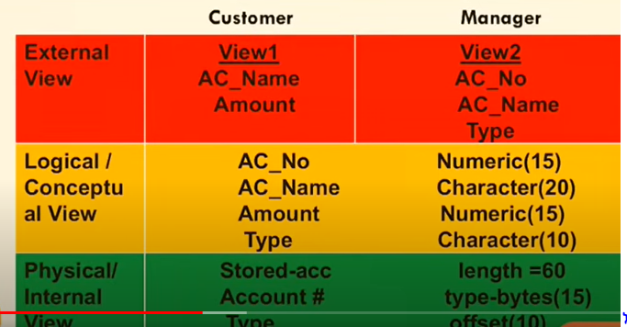

Slide 6
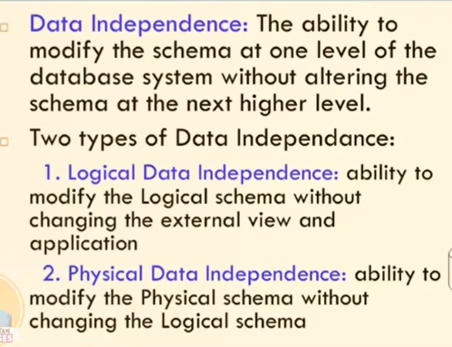
Data Independence

Slide 7
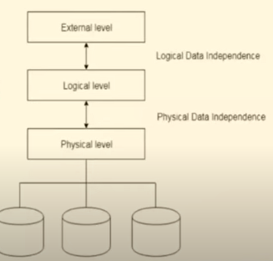
Data independence

Slide 8
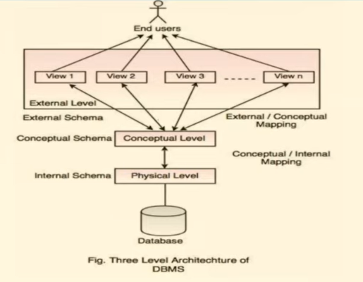
Three level DBMS Architecture

Slide 9
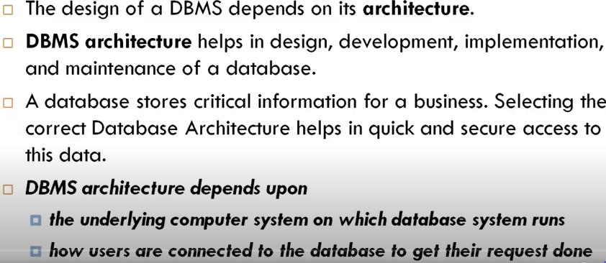
DBMS Architecture

Slide 10
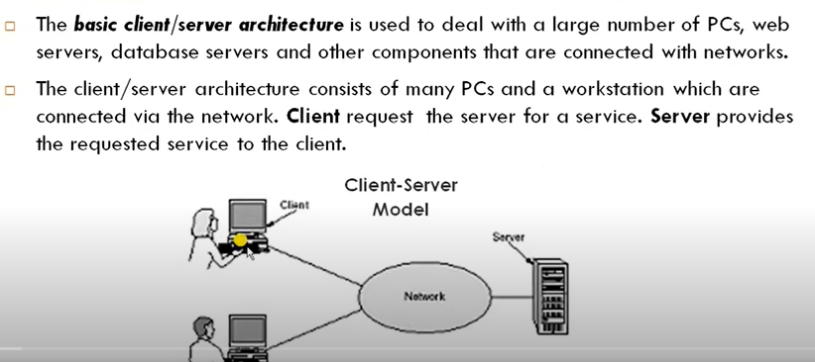
Client server architecture

Slide 11
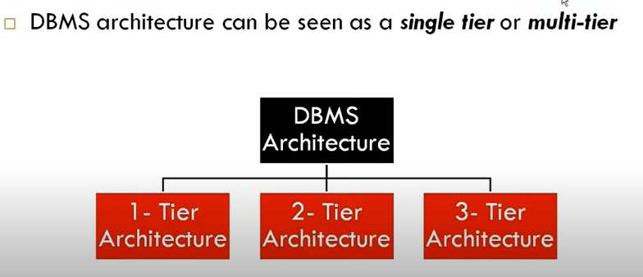
Types

Slide 12
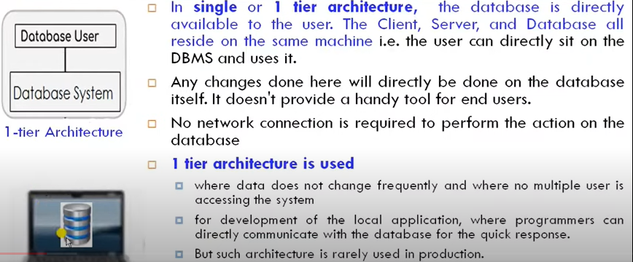
I tire Architecture

Slide 13
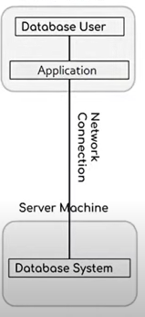
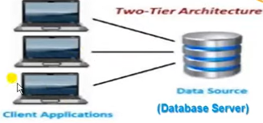
2 Tire Architecture

Slide 14
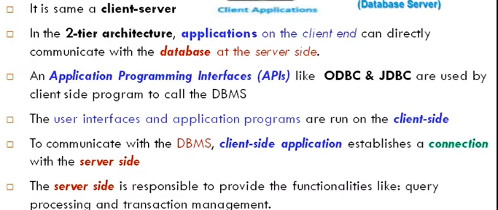
2 tire Architecture

Slide 15
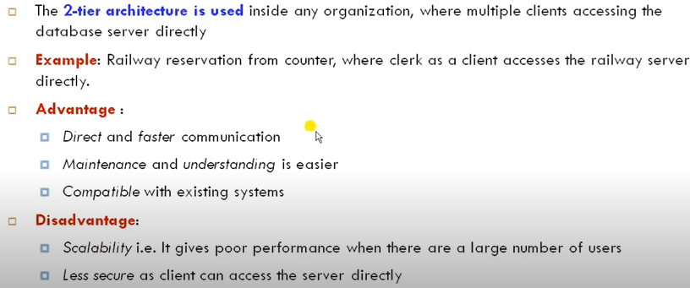
2 Tire examples

Slide 16
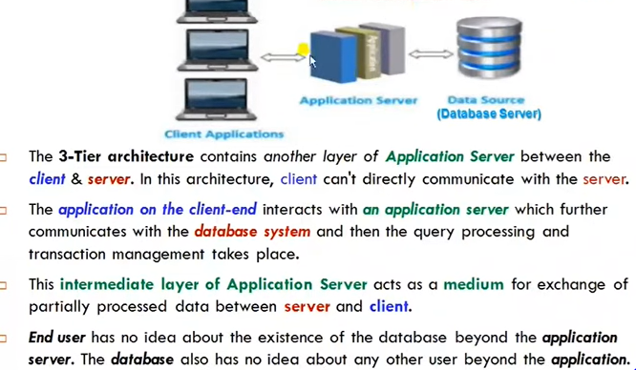
3 Tire Architecture

Slide 17
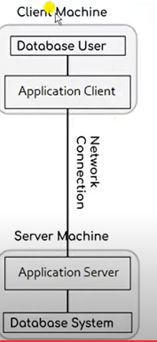
3 Tire Architecture

Slide 18
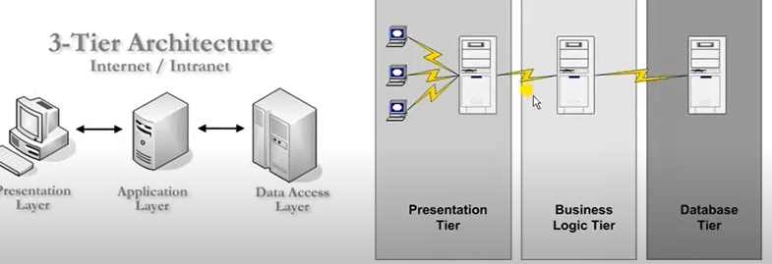
3 Tire Architecture

Slide 19
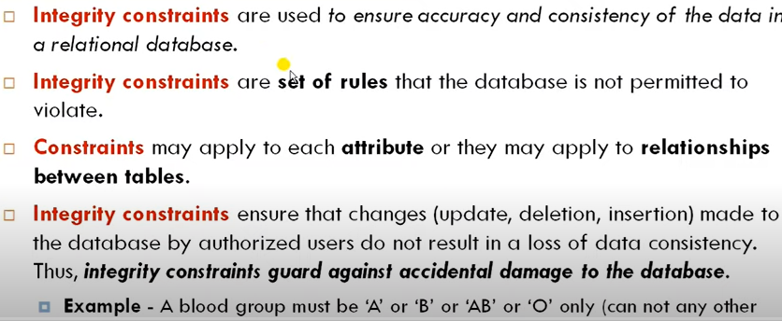
Integrity constraints

Slide 20
Constraints
Integrity Constraints
Impose restrictions on allowable data, beyond those
imposed by structure and types
Why use them?
Data entry error (during INSERT)
Correctness (during UPDATE)
Enforce consistency
Tell system about the data (e.g. uniqueness)
Notes:
So, why do we want to use constraints? Well, there's several reasons. Actually, one very practical reason is just to catch data entry errors. So, if we have constraints that just say that the values of the data are in the reasonable range, for example, our GPA's or our enrollments, then if somebody tries to enter data that violates the constraints they probably were just making a mistake, it was probably an error and that can be caught automatically by the constraint enforcement system in the database system.
So, a similar example is correctness criteria. So, data entry errors would be typically for inserts, where correctness criteria might be for updates. So, if we're modifying the database, for example, we updated GPA or an enrollment, if we're checking our constraints, that will make sure that our updates are correct - they don't have errors.
Another use of constraints is to enforce consistency. So we might have copies of data in the database in different places or some data that relies on other data and so when we have of that situation, consistency we could have constraints that specify the consistency requirements and are checked automatically and finally a very different use of constraint, is to tell the system about the data. So, specifically, we might have key constraints that say values are unique or we might again have consistency restraints that the system can use to both store the data in a certain fashion that made it more efficient and also for how it processes queries, query processing.

Slide 21
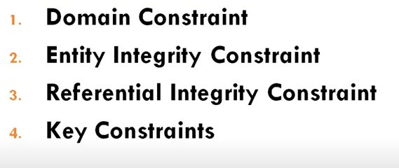
Types of Integrity constraints

Slide 22
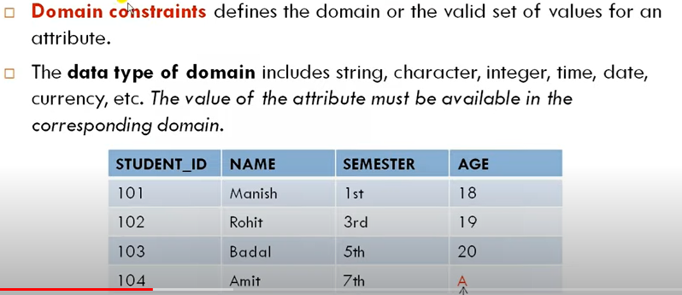
Domain constraints

Slide 23
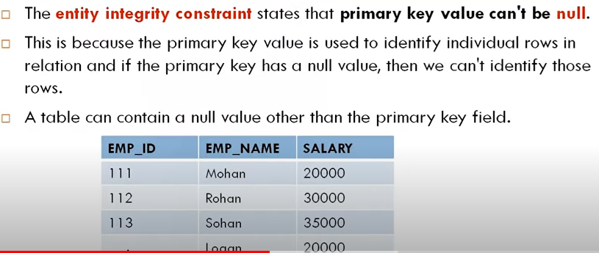
Entity integrity constraint

Slide 24
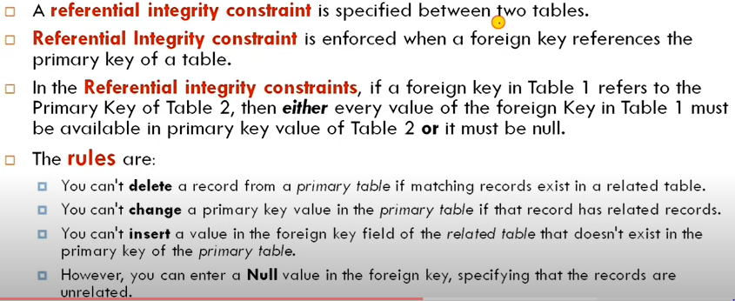
Referential Integrity constraint

Slide 25
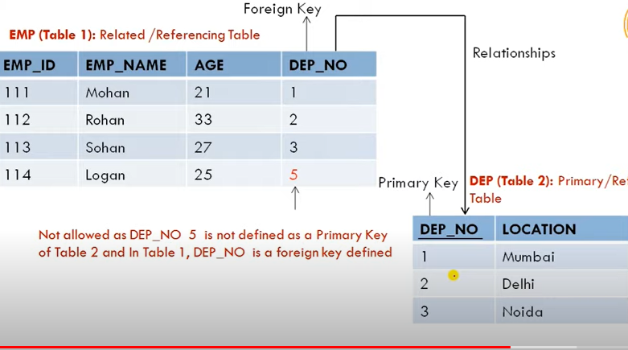
Referential Integrity constraint

Slide 26
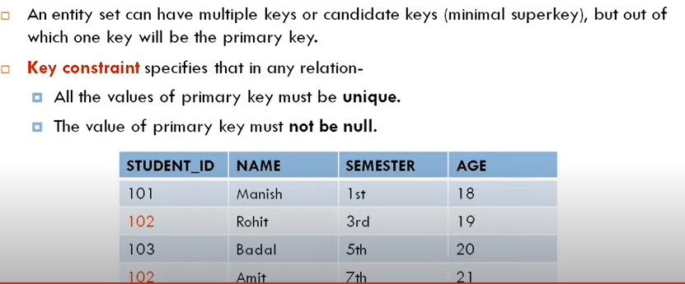
Key Constraint

Slide 27
Constraints
ATTRIBUTE-BASED CONSTRAINTS
GPA and sizeHS are in range
create table Student(sID int, sName text,
GPA real check(GPA <= 4.0 and GPA > 0.0),
sizeHS int check(sizeHS < 5000));
Simple university admissions database
University(uName,city,enrollment)
Student(sID,sName,GPA,sizeHS)
Apply(sID,uName,major,decision)

